Slide 1
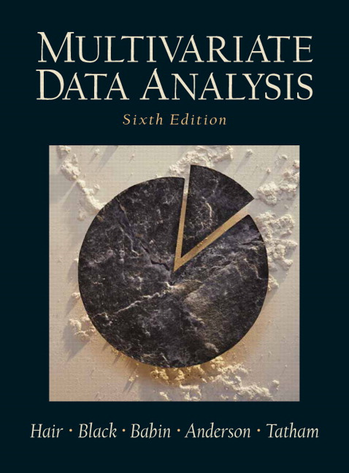
Chapter 2
Examining Your Data
Copyright © 2007
Prentice-Hall, Inc.

Slide 2
Chapter 2: Examining Your Data
LEARNING OBJECTIVES:
Upon completing this chapter, you should be able to do the following:
Select the appropriate graphical method to examine the characteristics of the data or relationships of interest.
Assess the type and potential impact of missing data.
Understand the different types of missing data processes.
Explain the advantages and disadvantages of the approaches available for dealing with missing data.
Identify univariate, bivariate, and multivariate outliers.
Test your data for the assumptions underlying most multivariate techniques.
Determine the best method of data transformation given a specific problem.
Understand how to incorporate nonmetric variables as metric variables.

Slide 3
Examination Phases:
Graphical examination.
Identify and evaluate missing values.
Identify and deal with outliers.
Check whether statistical assumptions are met.
Develop a preliminary understanding of your data.

Slide 4
Graphical Examination:
Shape:
  Histogram
  Bar Chart
  Box & Whisker plot
  Stem and Leaf plot
Relationships:
  Scatterplot
  Outliers

Slide 5
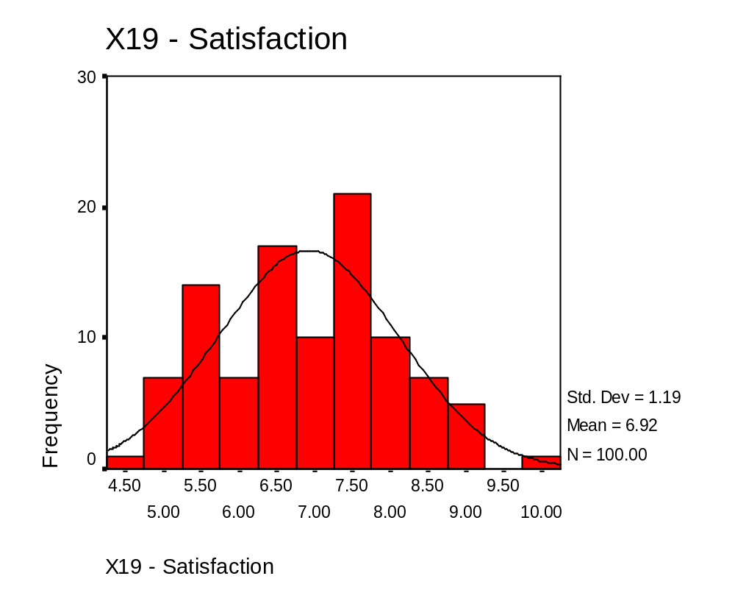
Histograms and The Normal Curve:
This is the distribution for HBAT database variable
X₁₉ – Satisfaction.

Slide 6
Stem & Leaf Diagram – HBAT Variable X₆
Each stem is shown by the numbers, and each number is a leaf. This stem has 10 leaves.
X6 - Product Quality Stem-and-Leaf Plot
Frequency Stem & Leaf
3.00 5 . 012
10.00 5 . 5567777899
10.00 6 . 0112344444
10.00 6 . 5567777999
5.00 7 . 01144
11.00 7 . 55666777899
9.00 8 . 000122234
14.00 8 . 55556667777778
18.00 9 . 001111222333333444
8.00 9 . 56699999
2.00 10 . 00
Stem width: 1.0
Each leaf: 1 case(s)
The length of the stem, indicated by the number of leaves, shows the frequency distribution. For this stem, the frequency is 14.
This table shows the distribution of X6 with a stem and leaf diagram (Figure 2.2). The first category is from 5.0 to 5.5, thus the stem is 5.0. There are three observations with values in this range (5.0, 5.1 and 5.2). This is shown as three leaves of 0, 1 and 2. These are also the three lowest values for X6. In the next stem, the stem value is again 5.0 and there are ten observations, ranging from 5.5 to 5.9. These correspond to the leaves of 5.5 to 5. 9. At the other end of the figure, the stem is 10.0. It is associated with two leaves (0 and 0), representing two values of10.0, the two highest values for X6.

Slide 7
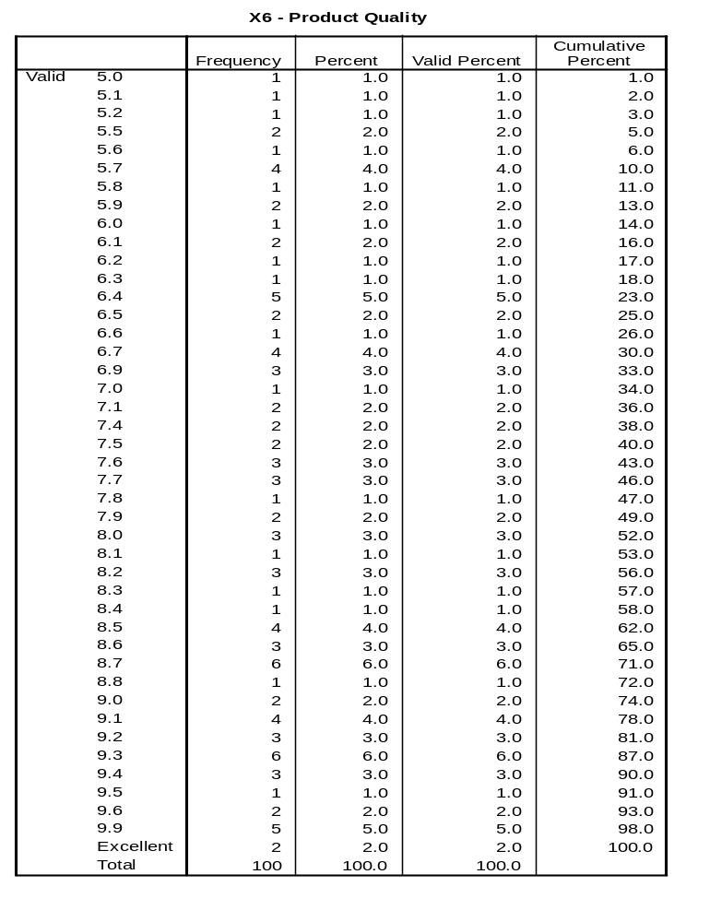
Frequency Distribution: Variable X6 – Product Quality

Slide 8
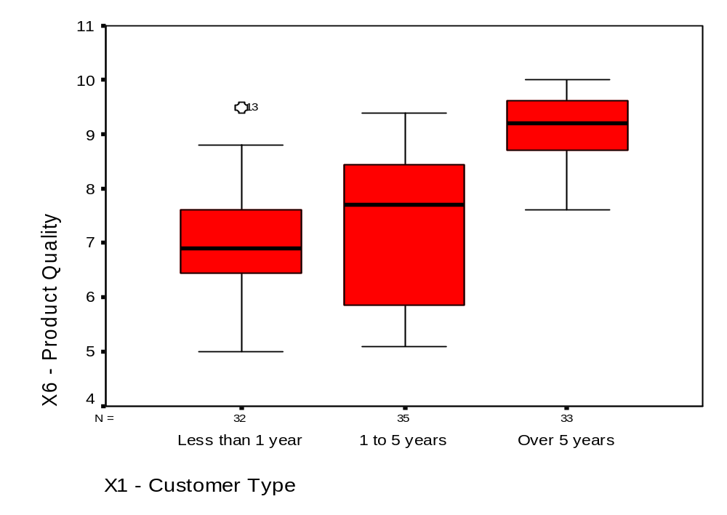
HBAT Diagnostics: Box & Whiskers Plots
Group 2 has substantially more dispersion than the other groups.
Outlier = #13
Median

Slide 9
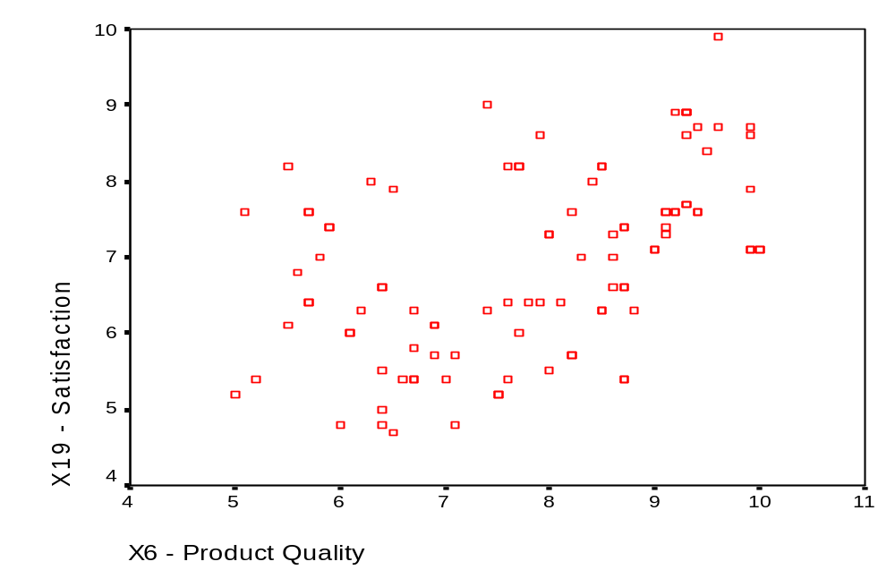
HBAT Scatterplot: Variables X₁₉ and X₆

Slide 10
Missing Data:
Missing Data = information not available for a subject (or case) about whom other information is available. Typically occurs when respondent fails to answer one or more questions in a survey.
    Systematic?
    Random?
Researcher’s Concern = to identify the patterns and relationships underlying the missing data in order to maintain as close as possible to the original distribution of values when any remedy is applied
Impact:
    Reduces sample size available for analysis.
    Can distort results.

Slide 11
Four-Step Process for Identifying Missing Data
Step 1: Determine the Type of Missing Data
Step 2: Determine the Extent of Missing Data
Step 3: Diagnose the Randomness of the Missing Data Processes
Step 4: Select the Imputation Method

Slide 12
Missing Data:
Strategies for handling missing data:
    use observations with complete data only;
    delete case(s) and/or variable(s);
    estimate missing values.

Slide 13
Rules of Thumb 2–1
How Much Missing Data Is Too Much?
Missing data under 10% for an individual case or observation can generally be ignored, except when the missing data occurs in a specific nonrandom fashion (e.g., concentration in a specific set of questions, attrition at the end of the questionnaire, etc.).
The number of cases with no missing data must be sufficient for the selected analysis technique if replacement values will not be substituted (imputed) for the missing data.

Slide 14
Rules of Thumb 2–3
Imputation of Missing data
Under 10% – Any of the imputation methods can be applied when missing data is this low, although the complete case method has been shown to be the least preferred.
10 to 20% – The increased presence of missing data makes the all available, hot deck case substitution and regression methods most preferred for MCAR data, while model-based methods are necessary with MAR missing data processes
Over 20% – If it is deemed necessary to impute missing data when the level is over 20%, the preferred methods are:
  the regression method for MCAR situations, and
  model-based methods when MAR missing data occurs.

Slide 15
Outlier
Outlier = an observation/response with a unique combination of characteristics identifiable as distinctly different from the other observations/responses.
Issue: “Is the observation/response representative of the population?”

Slide 16
Why Do Outliers Occur?
Procedural Error.
Extraordinary Event.
Extraordinary Observations.
Observations unique in their combination of values.

Slide 17
Dealing with Outliers:
Identify outliers.
Describe outliers.
Delete or Retain?

Slide 18
Identifying Outliers:
Standardize data and then identify
outliers in terms of number of
standard deviations.
Box Plots, Stem & Leaf, and Scatterplots.
Multivariate detection (D²).

Slide 19
Rules of Thumb 2–4
Outlier Detection
Univariate methods – examine all metric variables to identify unique or extreme observations.
For small samples (80 or fewer observations), outliers typically are defined as cases with standard scores of 2.5 or greater.
For larger sample sizes, increase the threshold value of standard scores up to 4.
If standard scores are not used, identify cases falling outside the ranges of 2.5 versus 4 standard deviations, depending on the sample size.
Bivariate methods – focus their use on specific variable relationships, such as the independent versus dependent variables:
  use scatterplots with confidence intervals at a specified Alpha level.
Multivariate methods – best suited for examining a complete variate, such as the independent variables in regression or the variables in factor analysis:
  threshold levels for the D2/df measure should be very conservative (.005 or .001), resulting in values of 2.5 (small samples) versus 3 or 4 in larger samples.

Slide 20
Multivariate Assumptions:
Normality
Linearity
Homoscedasticity
Non-correlated Errors
Data Transformations?

Slide 21
Testing Assumptions:
Normality assumptions
  Visual check of histogram.
  Kurtosis.
  Normal probability plot.
Homoscedasticity
  Equal variances across independent
  variables.
  Levene test (univariate).
  Box’s M (multivariate).

Slide 22
Rules of Thumb 2–5
Testing Statistical Assumptions
Normality can have serious effects in small samples (less than 50cases), but the impact effectively diminishes when sample sizes reach 200 cases or more.
Most cases of heteroscedasticity are a result of non-normality in one or more variables. Thus, remedying normality may not be needed due to sample size, but may be needed to equalize the variance.
Nonlinear relationships can be very well defined, but seriously understated unless the data is transformed to a linear pattern or explicit model components are used to represent the nonlinear portion of the relationship.
Correlated errors arise from a process that must be treated much like missing data. That is, the researcher must first define the “causes” among variables either internal or external to the dataset. If they are not found and remedied, serious biases can occur in the results, many times unknown to the researcher.

Slide 23
Data Transformations ?
Data transformations . . . provide a means of modifying variables for one of two reasons:
To correct violations of the statistical assumptions underlying the multivariate techniques, or
To improve the relationship (correlation) between the variables.

Slide 24
Rules of Thumb 2–6
Transforming Data
To judge the potential impact of a transformation, calculate the ratio of the variable’s mean to its standard deviation:
  Noticeable effects should occur when the ratio is less than 4.
  When the transformation can be performed on either of two variables, select the variable with the smallest ratio .
Transformations should be applied to the independent variables except in the case of heteroscedasticity.
Heteroscedasticity can be remedied only by the transformation of the dependent variable in a dependence relationship. If a heteroscedastic relationship is also nonlinear, the dependent variable, and perhaps the independent variables, must be transformed.
Transformations may change the interpretation of the variables. For example, transforming variables by taking their logarithm translates the relationship into a measure of proportional change (elasticity). Always be sure to explore thoroughly the possible interpretations of the transformed variables.
Use variables in their original (untransformed) format when profiling or interpreting results.

Slide 25
Dummy Variable
Dummy variable . . . a nonmetric independent variable that has two (or more) distinct levels that are coded 0 and 1. These variables act as replacement variables to enable nonmetric variables to be used as metric variables.

Slide 26
Dummy Variable Coding
Category X₁ X₂
Physician 1 0
Attorney 0 1
Professor 0 0

Slide 27
Simple Approaches to Understanding Data
Tabulation = a listing of how respondents answered all possible answers to each question. This typically is shown in a frequency table.
Cross Tabulation = a listing of how respondents answered two or more questions. This typically is shown in a two-way frequency table to enable comparisons between groups.
Chi-Square = a statistic that tests for significant differences between the frequency distributions for two (or more) categorical variables (non-metric) in a cross-tabulation table. Note: Chi square results will be distorted if more than 20 percent of the cells have an expected count of less than 5, or if any cell has an expected count of less than 1.
ANOVA = a statistic that tests for significant differences between two means.

Slide 28
Examining Data
Learning Checkpoint:
Why examine your data?
What are the principal aspects of data that need to be examined?
What approaches would you use?

